Slide 1

Summer Internship program 2021 “ Sip-21”
Progress Detail ( Week – 1)

Slide 2

Outlines
1.
3.
4.
5.
2.
GitHub
W3 schools
LeetCode
HackerRank
C++ Program

Slide 3


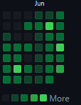
GitHub Progress

Slide 4


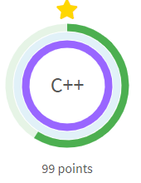
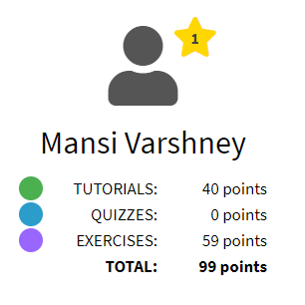
W3 schools Progress
In Programming-
C++

Slide 5


LeetCode Progress
Solved a problem on leetcode...rest in progress

Slide 6

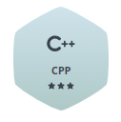
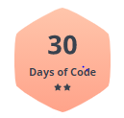
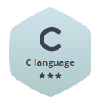
HackerRank Progress

Slide 7

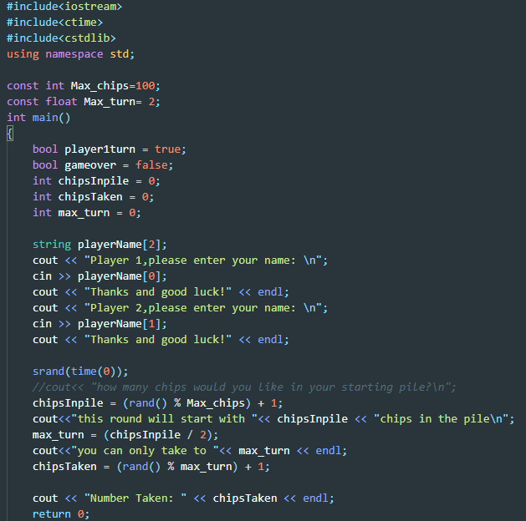
C++ Program

Slide 8
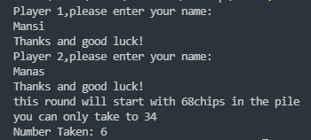
Output of Previous program

Slide 9

The best way to predict the future is to create it. -Abraham Lincoln

Slide 10

Thank You!

